Slide 1
Predicting Restaurants’ Violations of Allegheny County
Hawraa Salami
SPRINGBOARD Capstone Project 2

Slide 2
Inspection of Food Facilities in Allegheny County
Food facilities should at least be inspected once a year.
Due to shortage in staff, several restaurants have not been inspected since 2017.
Data-driven models can help the county in prioritizing its inspections.

Slide 3


Our Approach
What features of food facilities can predict their future violations?
Our approach is to combine information from two datasets:
Dataset of violations detected during inspection in Allegheny County
Dataset of Yelp reviews for food facilities of Allegheny County

Slide 4
How Can the Model Help?
Allegheny County
Improve the inspection process:
identify which restaurants to target first
reduce the number of violations missed
detect any risks earlier

Slide 5
Datasets: Violation & Yelp Reviews
Violation Data
Yelp Data
Inspection Date
Numbers of:
Low, Medium, High violations
Description of the food facility
Address of the facility
ID of the facility
Attributes of facilities (price range, ambience, alcohol, good for kids, … )
Categories of facilities (cuisine, special food, description of the place)
Text reviews, number of star given by customers
Business ID of the facility

Slide 6
Data Wrangling
Data Cleaning & Finding the Common Facilities

Slide 7
Data Wrangling
1. Violation Dataset
Filled missing addresses using facilities dataset Fixed the IDs of the same restaurants that have multiple IDS (by relying on their name and address)
2. Yelp Reviews
Fixed the business IDs of the same restaurants that have multiple IDS Extracted categories and attributes each as one column Normalized Text Reviews
3. Mapping the IDs of the facilities
Used the name and address of food facilities to find the mapping between the two datasets

Slide 8
Exploratory Analysis
Data Visualizations & Statistical Analysis

Slide 9
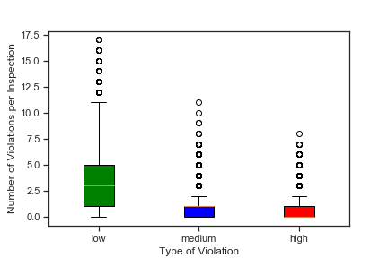
Types of Violations

Slide 10
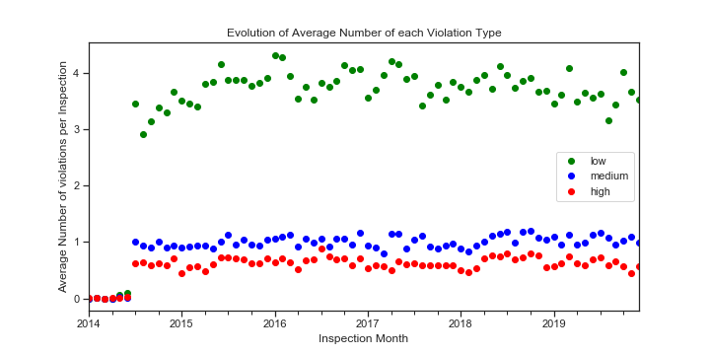
Evolution of Average Number of Violations

Slide 11
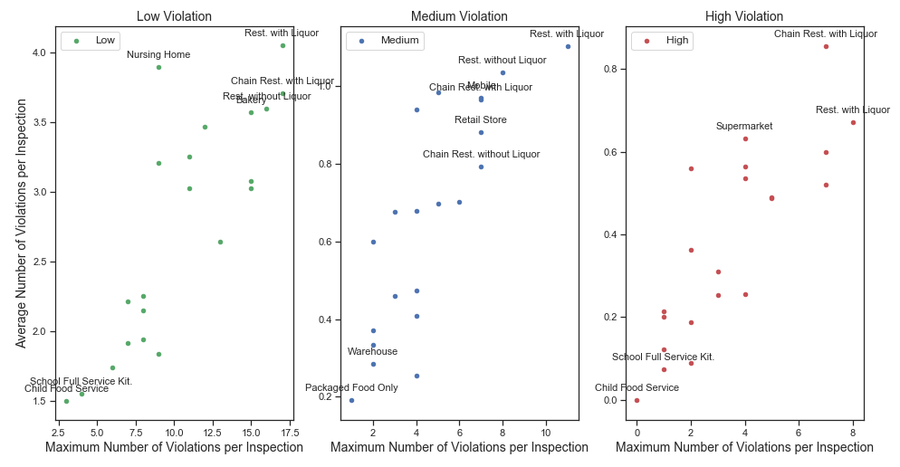
Violations vs Features of Food Facilities: ‘Description’

Slide 12
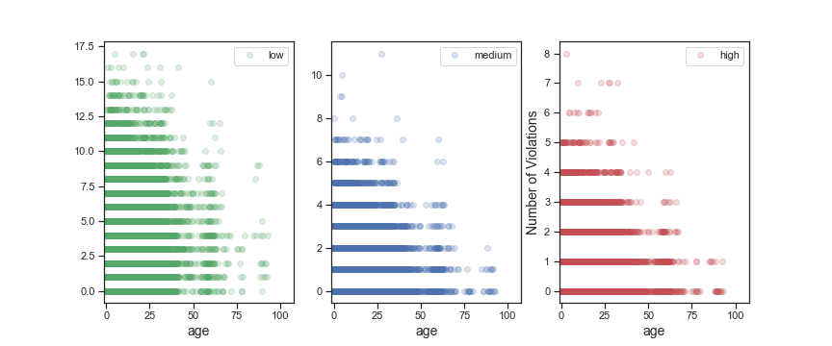
Violations vs Features of Food Facilities: ‘Age’

Slide 13
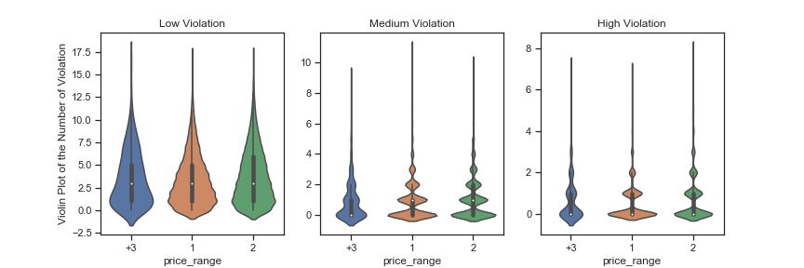
Violations vs Features of Food Facilities: ‘Price Range’

Slide 14
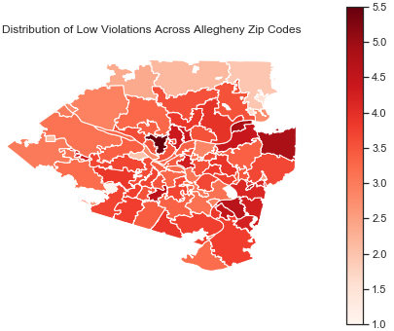
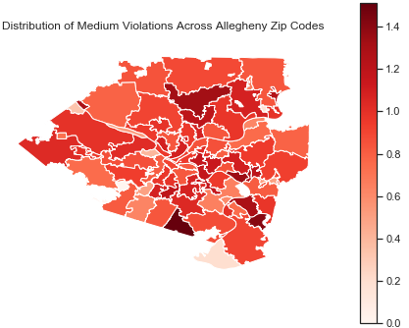
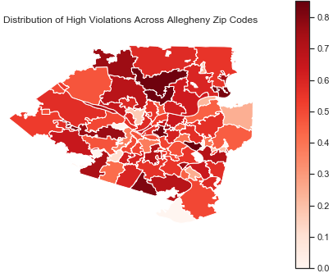
Violations vs Features of Food Facilities: ‘Zip Codes’

Slide 15
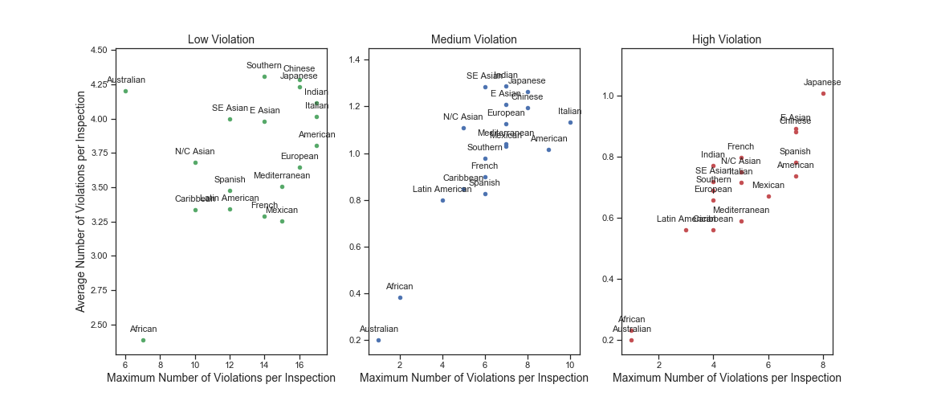
Violations vs Features of Food Facilities: ‘Cuisine’

Slide 16
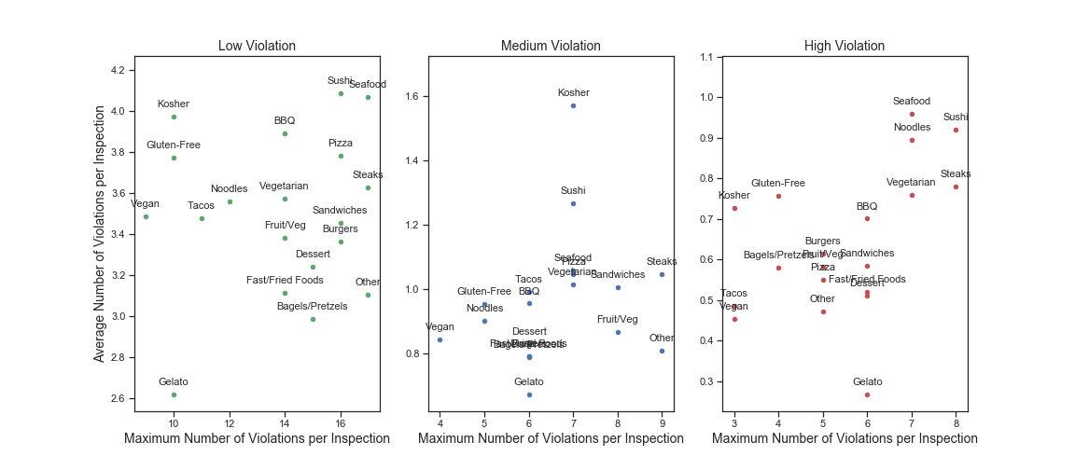
Violations vs Features of Food Facilities: ‘Specialty Food’

Slide 17
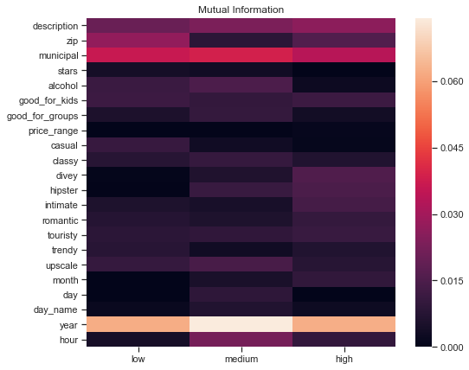
Mutual Information between some Features and Number of Violations

Slide 18
Historical Performance of Past Inspections
We added columns that capture past performance of each inspected place:
Inspection number
Number of days between inspections
Statistics of Past performance

Slide 19
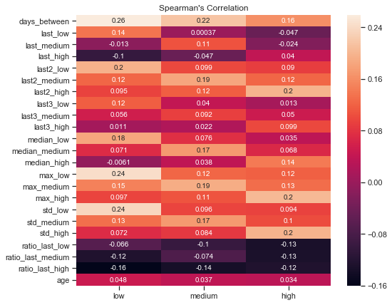
Correlation between Past Performance and Violations

Slide 20
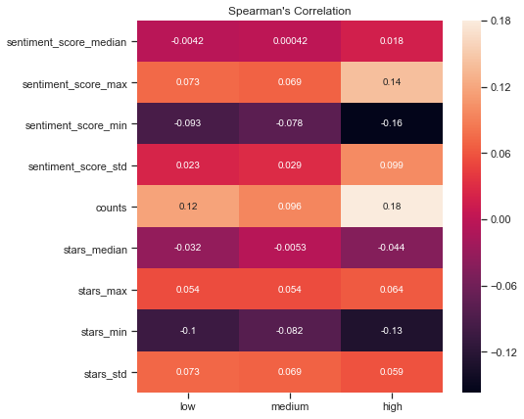
Analysis of Reviews 1. Sentiment Analysis
Focused on reviews mentioned before the inspection date:
compute their sentiment scores
find their rolling statistics
add the total number of reviews and the average number of stars

Slide 21
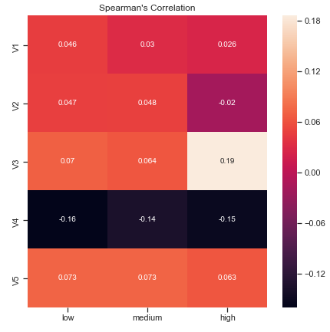
Analysis of Reviews 2. Topic Modeling
Extracted 5 topics from the reviews :
Topic 1: bar beer wing drink place good bartender great burger night
Topic 2: pizza order delivery good crust place cheese wing sauce get
Topic 3: food good order go get place service restaurant come time
Topic 4: coffee store get place go shop good one like make
Topic 5: chinese sushi food roll good chicken rice order place thai

Slide 22
Building Predictive Models
In-Depth Analysis

Slide 23
Predicting Future Performances
Two possible approaches to explore:
1- Regression: estimate the number of future low, medium and high violations
2- Classification: classify a future inspection as a fail or pass
Preprocessing steps:
1- Split the data into 80% for training and 20% for testing
Test set corresponds to future inspections for the training set.
2- Encode the nominal columns (tried one hot, label encoding)

Slide 24
Like Nested Cross-Validation
Test (Validation) set: future inspections for the training (sub-training) set
Split the data:
Perform like-nested cross-validation on the training set:
Training: 80%
Testing: 20%
Sub-Training:
40%
Validation: 20%
Train different models
Find their average performances
Select best model
Sub-Training:
60%
Validation: 20%
Sub-Training:
80%
Validation: 20%

Slide 25
Regression Training Models
Tried training with and without feature selection
Feature selection: filter method using mutual information
Tried different models: linear support vector regressor and tree based models: random forest, ada boost, and gradient boosting regressors
Metric performance: mean-squared error (MSE)

Slide 26
Final Regression Model
Final Models selected for each type of violation:
Low: Label encoding + feature selection + gradient boosting
MSE: 5.83 - R2: 0.24
Medium: One hot encoding + feature selection + gradient boosting
MSE: 1.30 - R2: 0.16
High: One hot encoding + feature selection+ gradient boosting
MSE: 0.76 – R2: 0.13
The models do not fit well the data; regression might be a difficult task

Slide 27
Classification Approach
Each inspection is classified:
1: Fail, at least 1 high violation or more than 2 medium violations
0: Pass, otherwise
Trained different classification problems with or without feature selection
Performance Metric: accuracy

Slide 28
Final Model Performance
Final Model: Label Encoding + Gradient Boosting (without feature selection)
Performance: accuracy of 67.65%
Class: 1 (Fail) Class: 0 (Pass)
Precision: 0.67 Precision: 0.68
Recall 0.74 Recall: 0.60

Slide 29
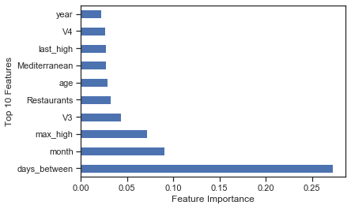
Feature Importance

Slide 30
Possible Future Works
Aggregate different types of classification models in addition to the gradient boosting classifier
Use additional data from Allegheny website for restaurants' inspections with no violation
Explore the reports of violation to extract more information related to the inspection.

Slide 31
Recommendation
Collect more information related to the inspected place: number of employees, their level of expertise, their culinary background, information about the manager, size of the business, busy hours
Collect more attributes of restaurants (many of the attributes were missing from the data)
Encourage people to leave more reviews related to the level of cleanness noticed in the restaurants (restrooms, utensils, quality of food served in terms of freshness)

